Slide 1



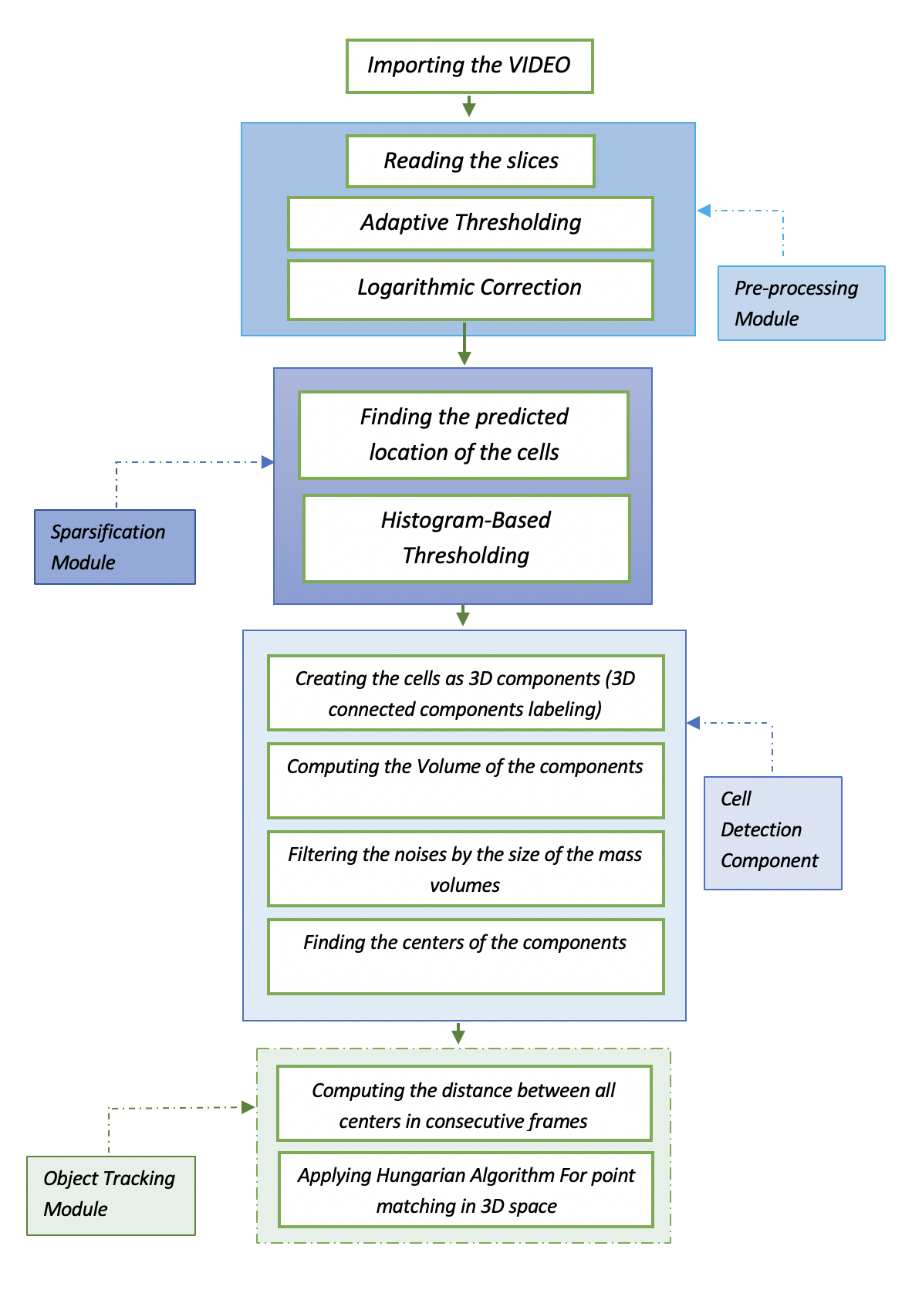
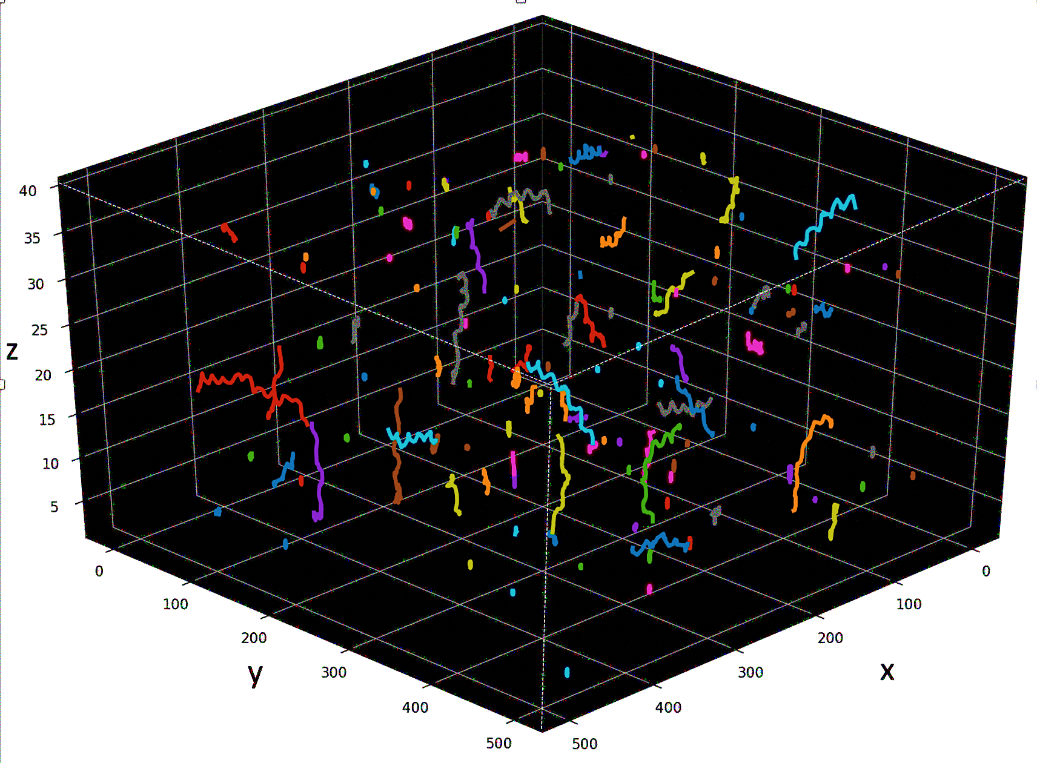
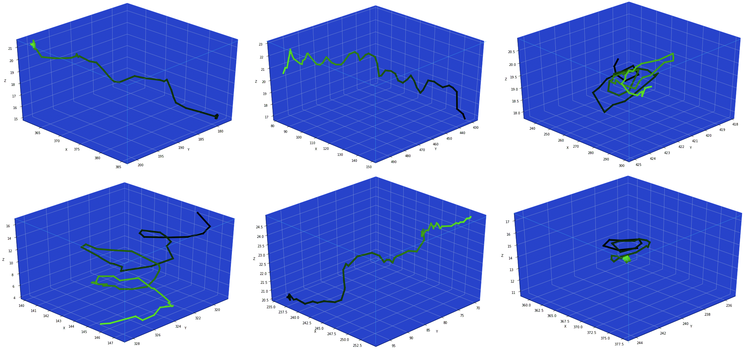
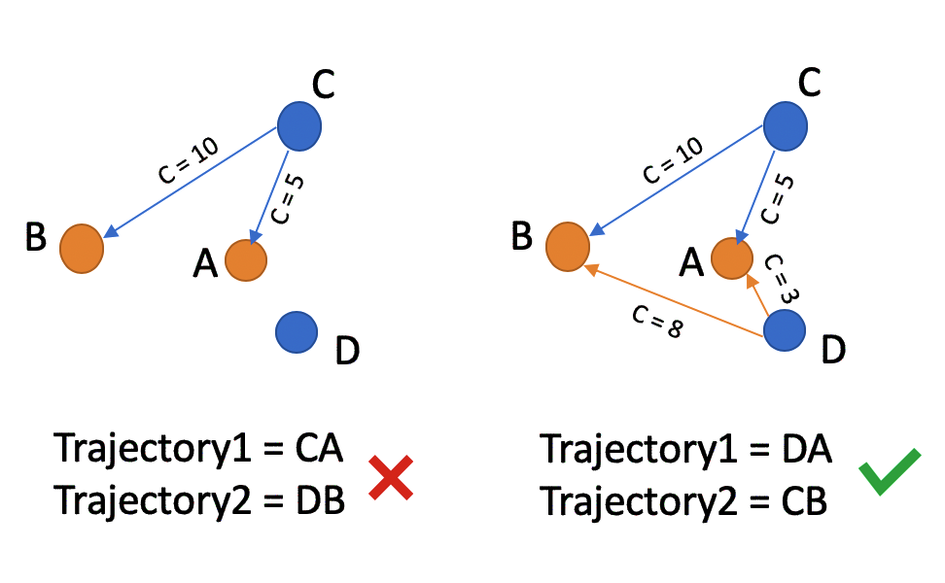
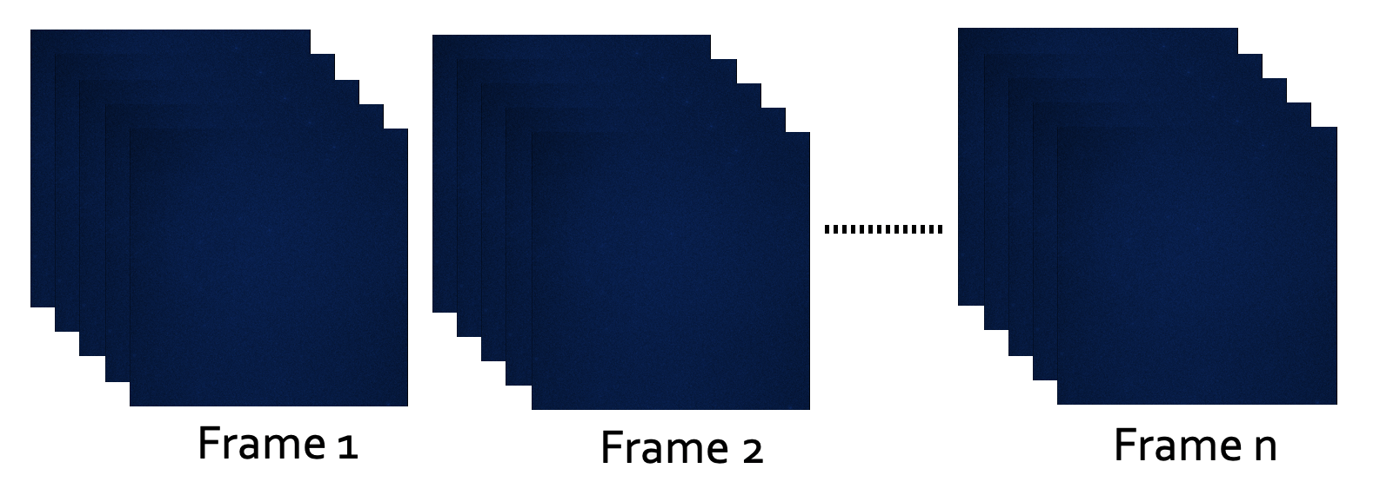
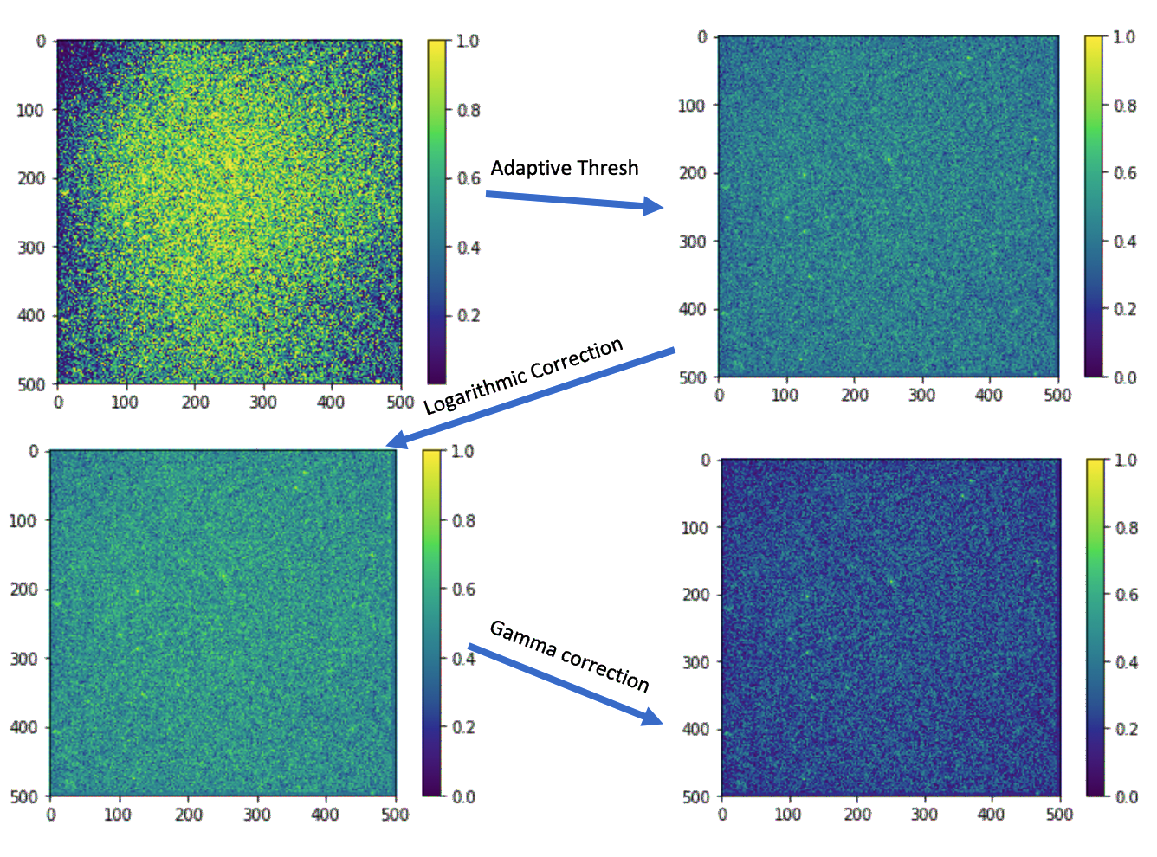
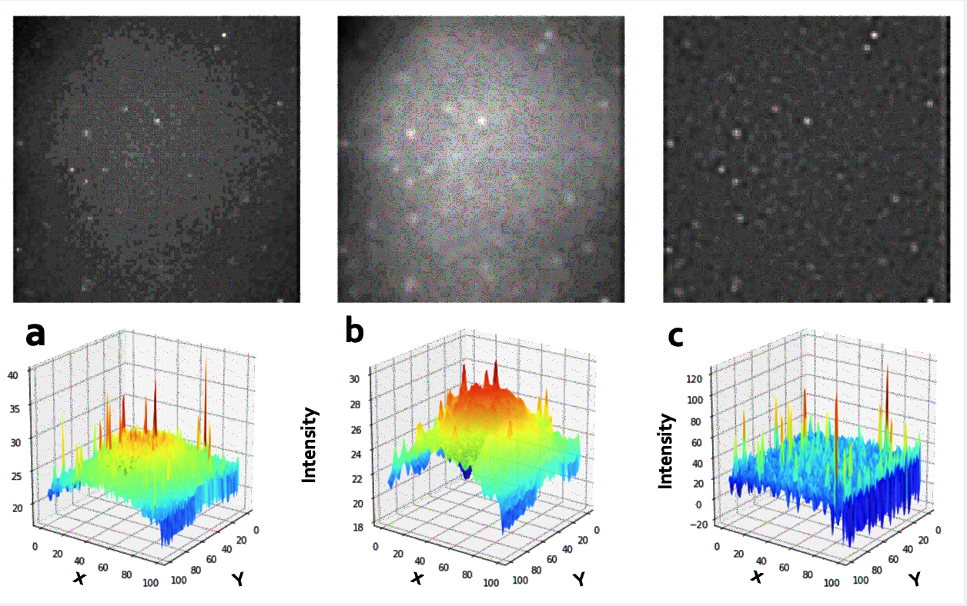
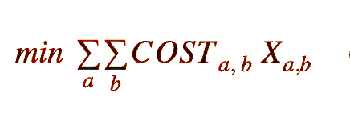
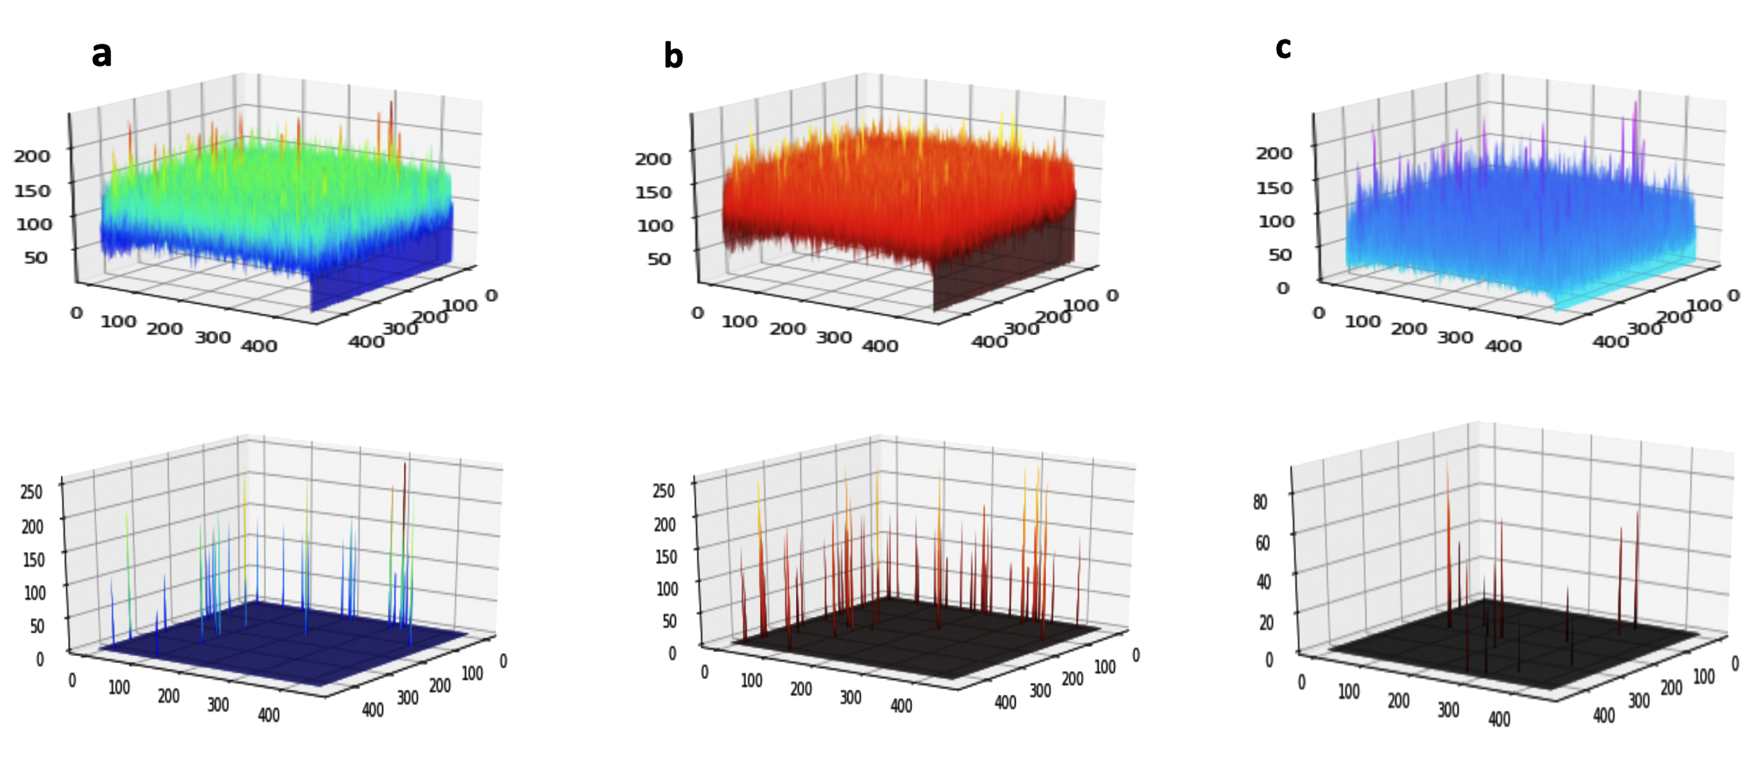
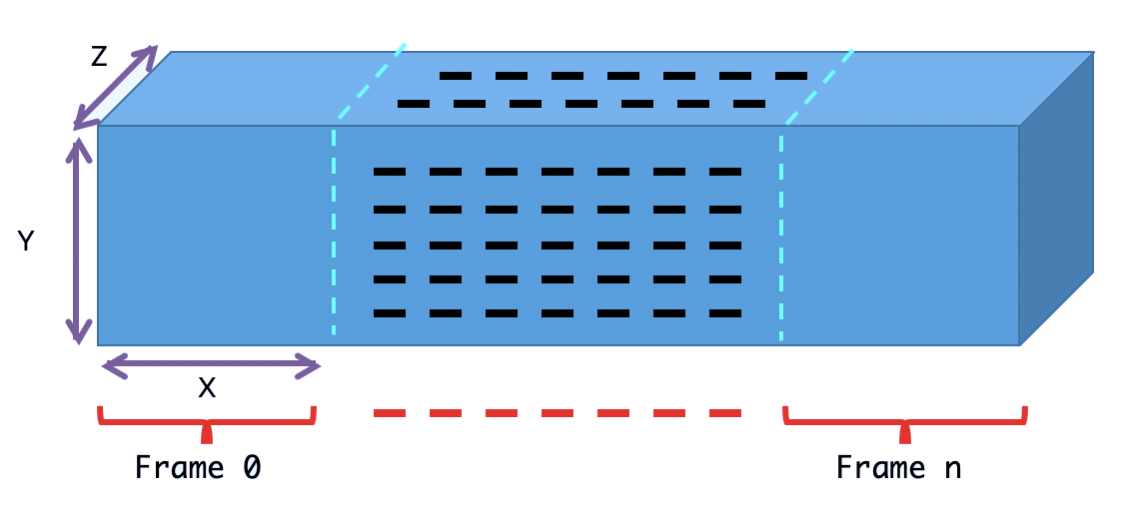
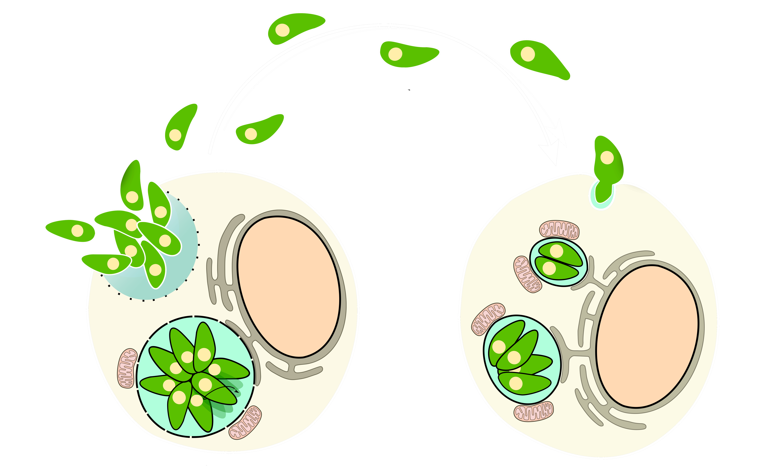
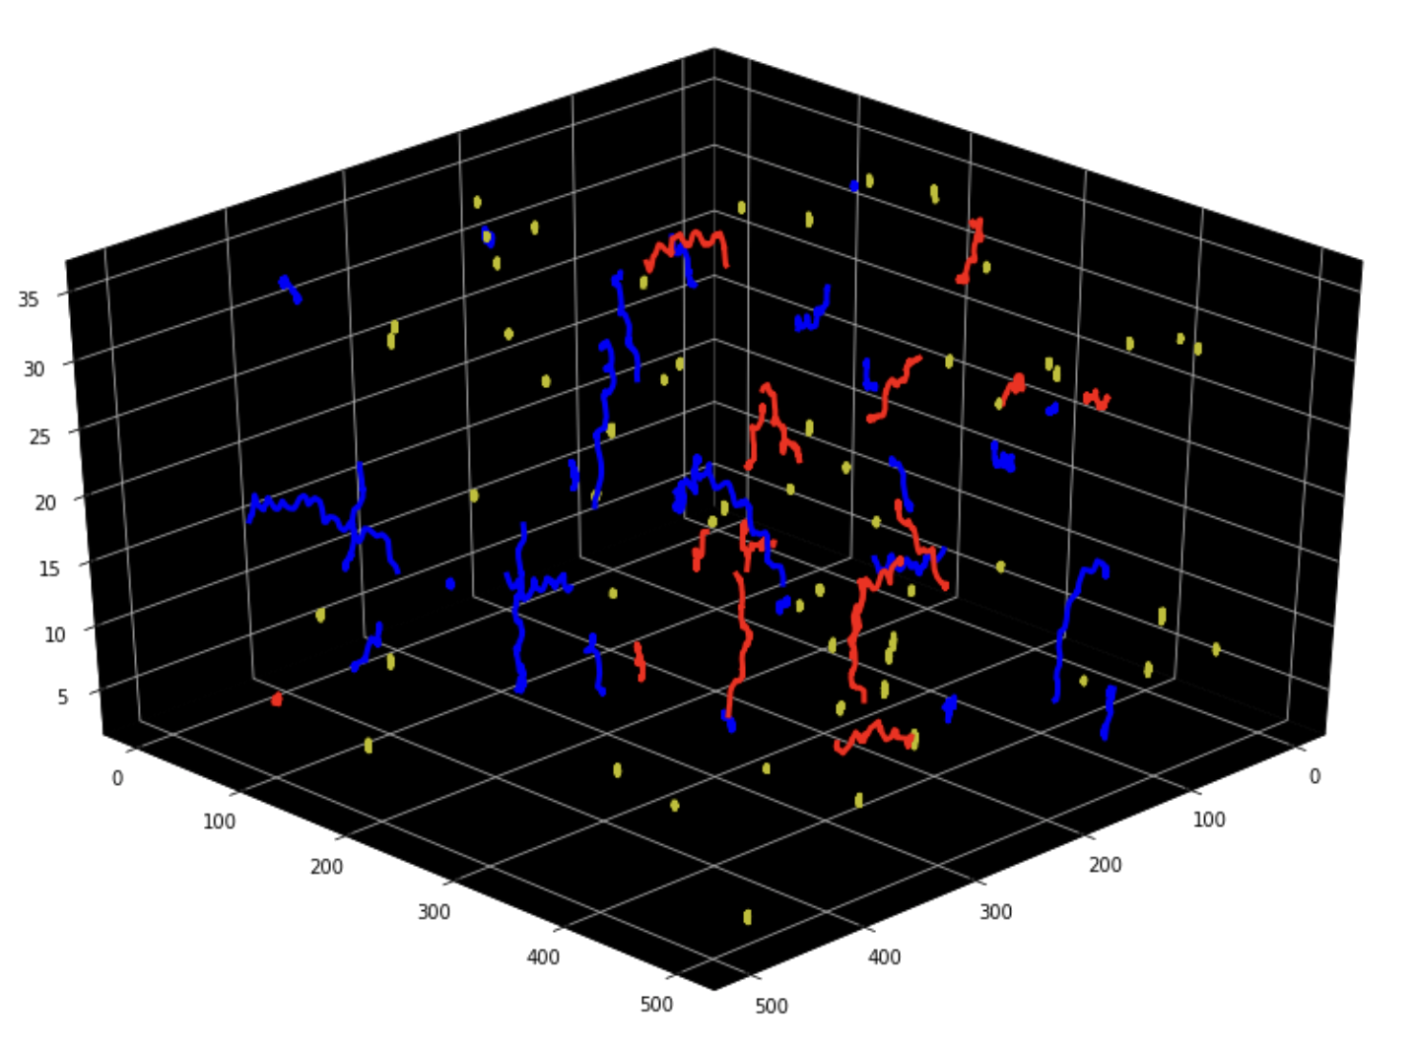
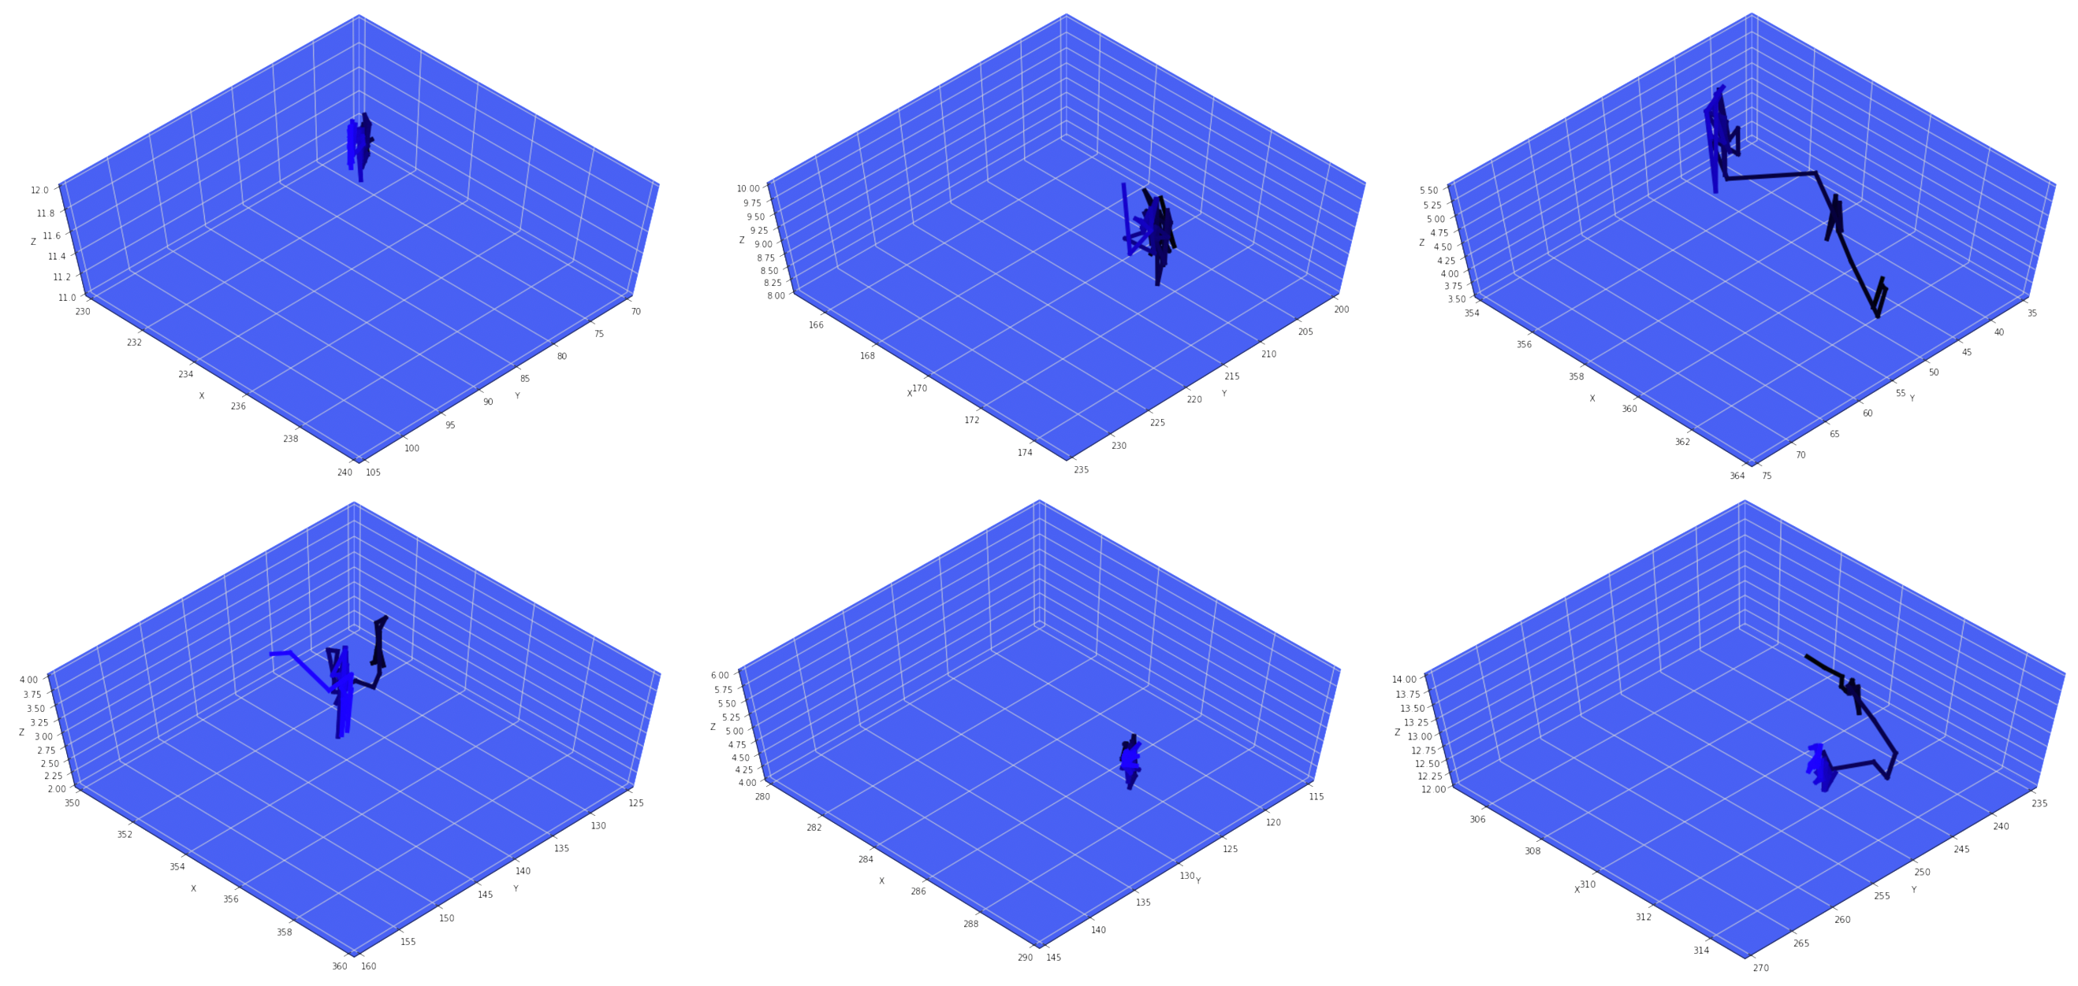
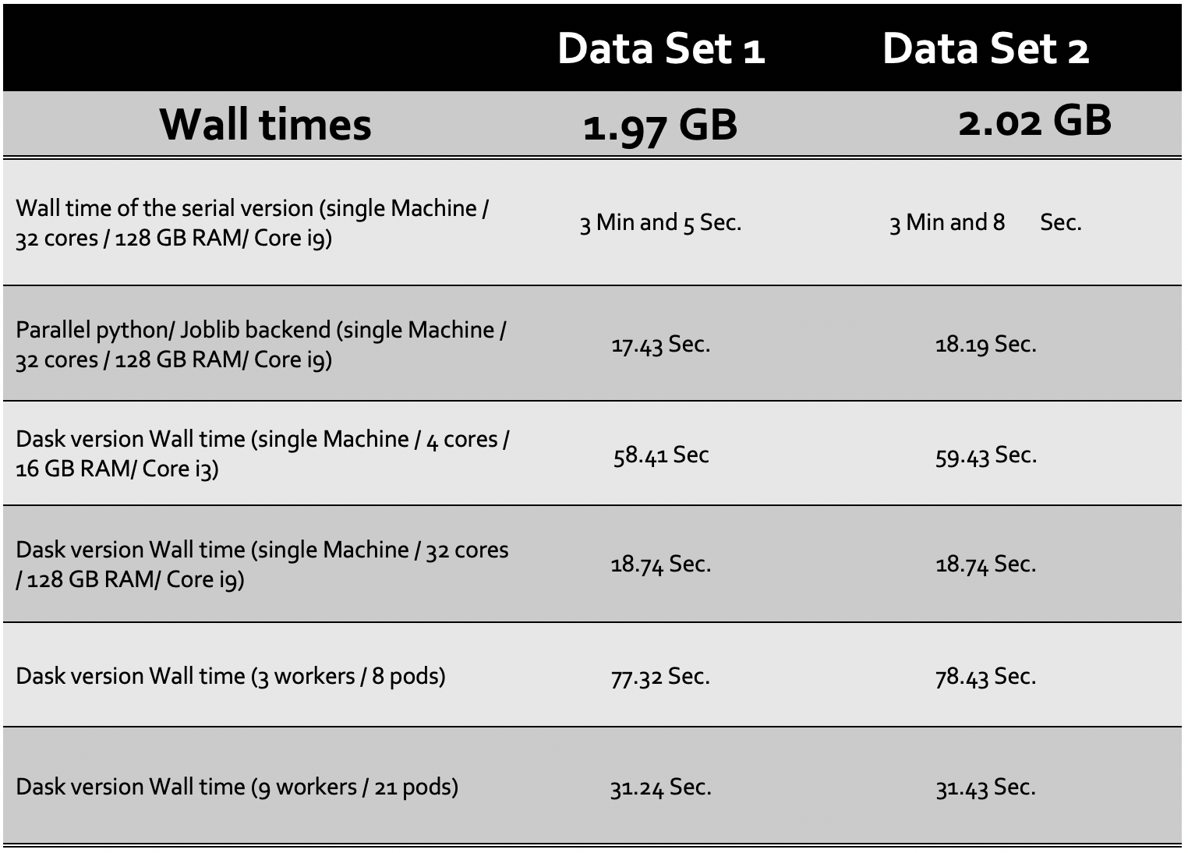
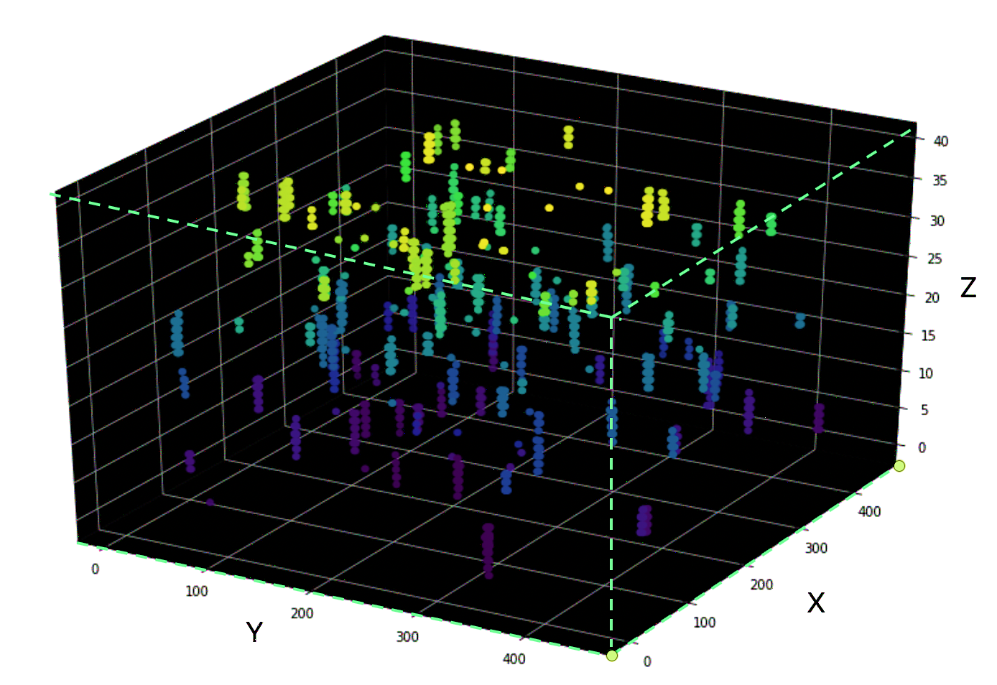
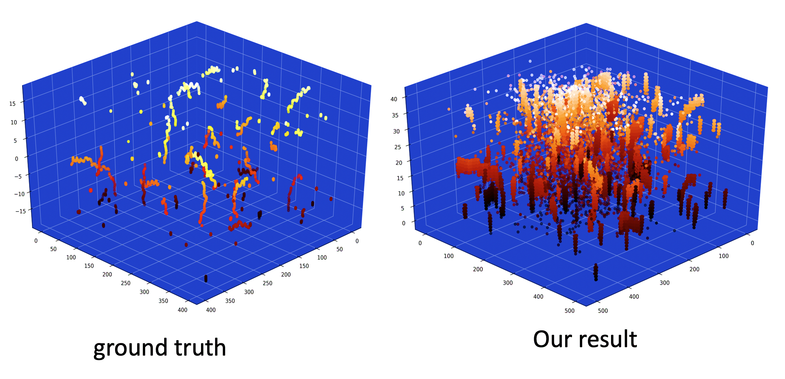
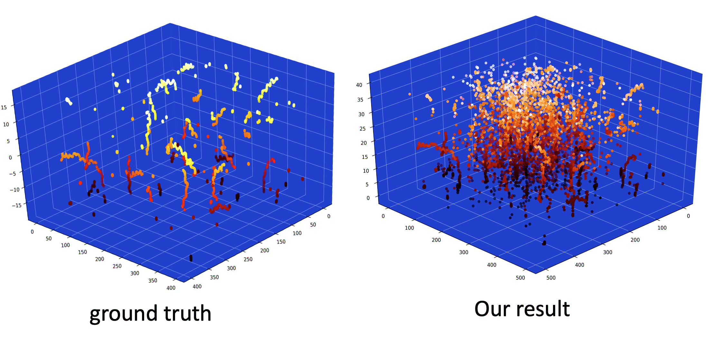
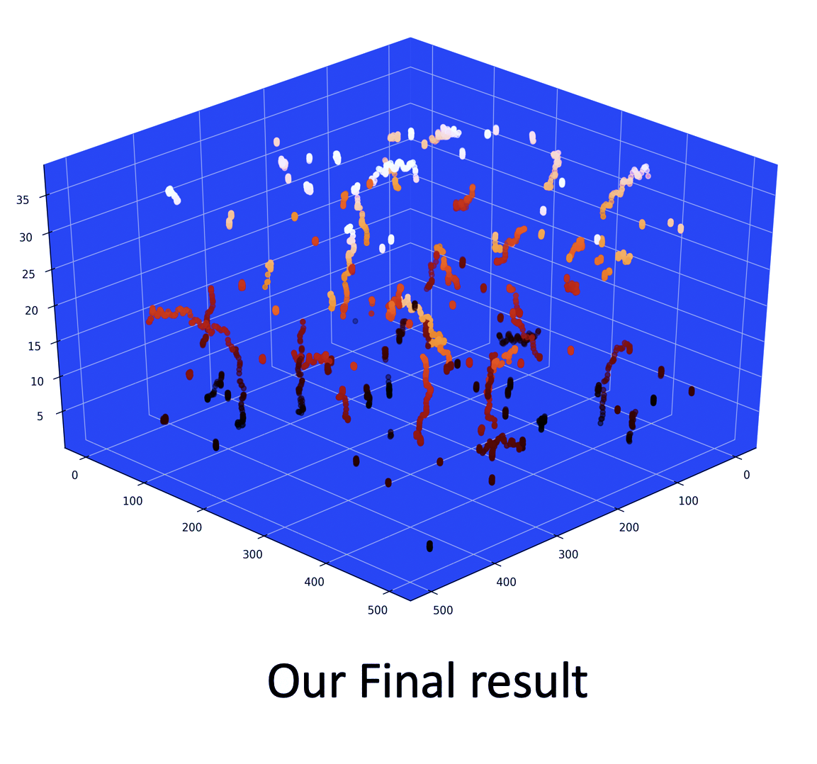
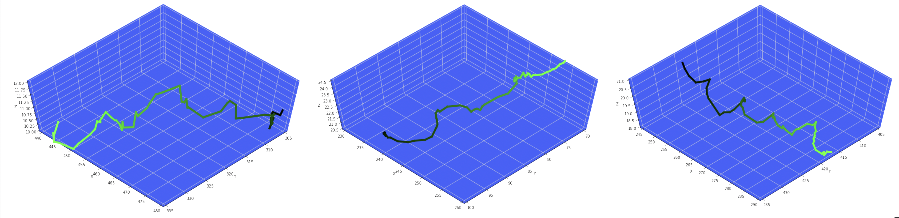
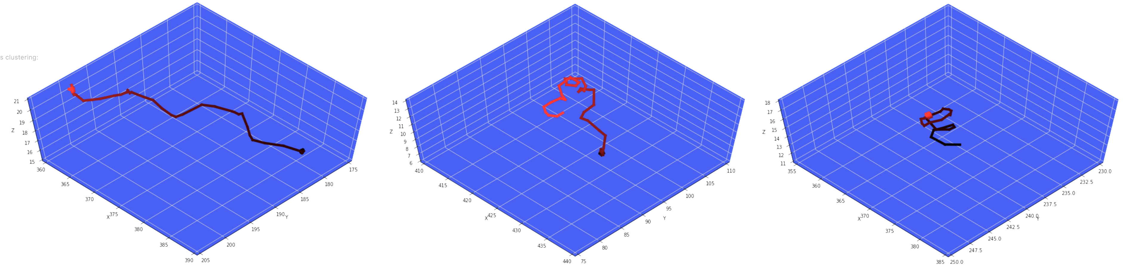
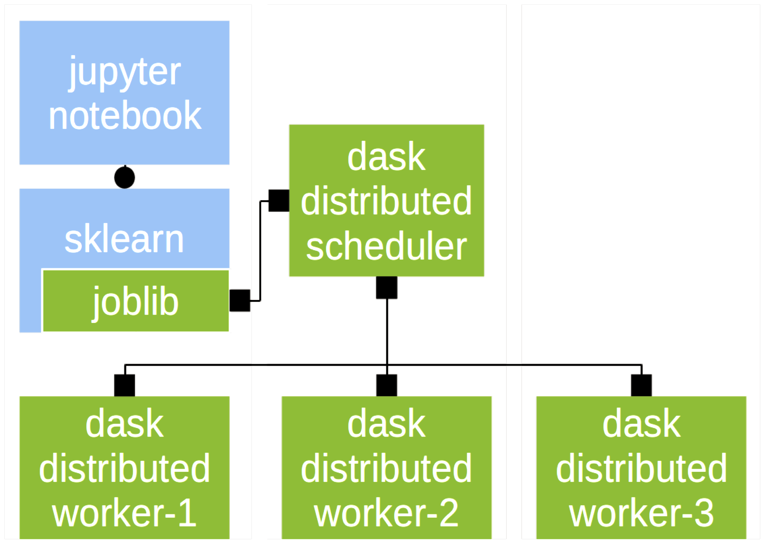
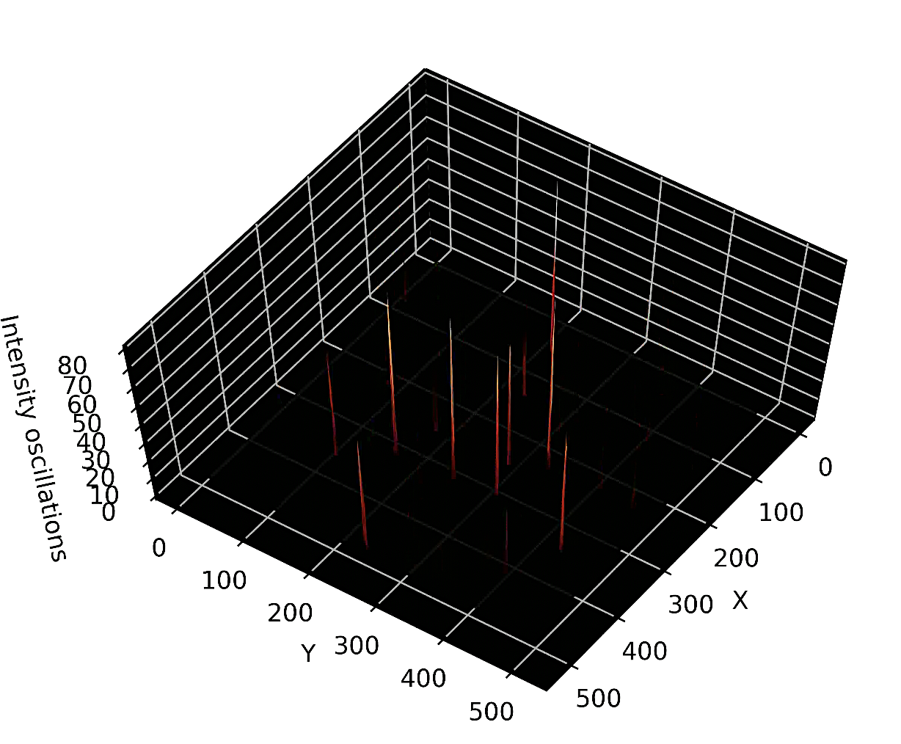
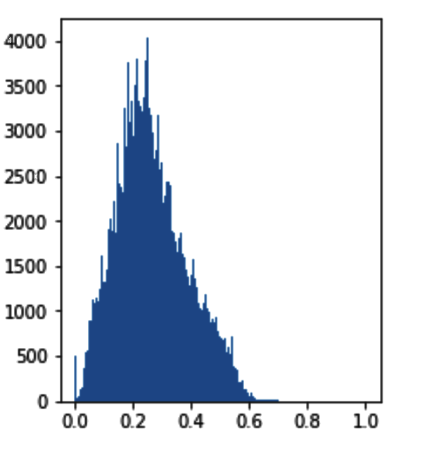
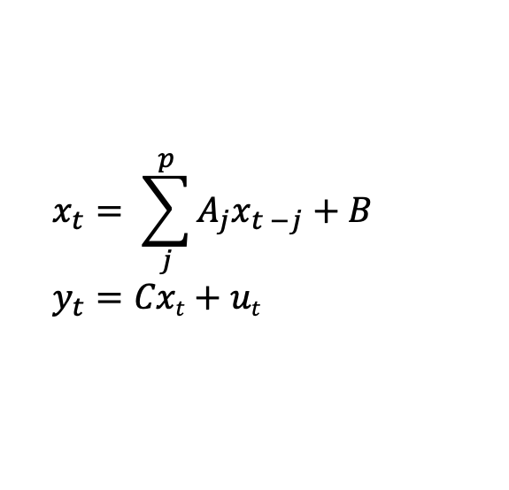
Scalable 3D Tracking and Clustering of Toxoplasma gondii Motion Phenotypes
Mojtaba S. Fazli*, Stephen Vella**, Silvia N.J. Moreno**, Gary E. Ward***, Shannon Quinn*,**
* Department of Computer Science, University of Georgia
** Department of Cellular Biology Center for Tropical and Emerging Global Diseases, University of Georgia,
*** Department of Microbiology and Molecular Genetics, University of Vermont
Abstract:
Tracking Pipeline:
Tracking Module and Parallelization
Toxoplasma gondii is a parasitic protozoan that causes disseminated toxoplasmosis, a disease that afflicts roughly a third of the worlds population. Its virulence is predicated on its motility and ability to enter and exit nucleated cells; therefore, studies elucidating its mechanism of motility and in particular, its motility patterns in the context of its lytic cycle, are critical to the eventual development of therapeutic strategies. Here, we present an end-to-end computational pipeline for identifying T. gondii motility phenotypes in a completely unsupervised, data-driven way. We track the parasites before and after addition of extracellular Ca²⁺ to study its effects on the parasite motility patterns and use this information to parameterize the motion and group it according to similarity of spatiotemporal dynamics.
Figure 3) we import all the video slices as TIFF image files, then we convert them into numpy arrays. Our next step is to apply some preprocessing on our data. After that, our pipeline makes a sparse matrix, detects the cells in 3D space, and finally tracks the objects by minimizing the cost between the points in consecutive frames.. Our framework consists of 4 different modules, these modules are :
Pre-processing
Sparsification
Cell Detection
Cell Tracking
3D Video Tracking : Pre-Processing steps
Figure 2 ( I ) In 3D microscopic videos, in each frame, we are dealing with a set of slices that determine the depth of the image. ( II ) To remove the noise and finding the position of the cell particles we used 2 methods First (left ) we tried smoothing and then sharpening the edges. (a) normal image and its 3d intensity map. (b)The smoothed version of the image and it’s intensity map. (c) the sharpened version of image in part (b). The 2nd method (Right) relies on several filtering techniques. first we applied the adaptive thresholding on the original image. (III) : To select the best possible result among them, we have plotted their intensity map before and after thresholding. As it illustrated in Figure 2 part (III) the result of aplplying Adaptive thresholding + logarithmic correction and then thresholding in order to save the spikes, which shows the possible location of the cells, works best ( part C ) .
( I )
A
B
C
For tracking part we used Hungarian algorithm between the points in the current frame and the one in our last selected objects positions. The Hungarian algorithm is a combinatorial optimization algorithm. This method solves the assignment problem in polynomial time . the optimal assignment has the cost of :
Figure 5) Part A , shows the 3D tracking results . Each trajectory is colored by different colors. Part B, illustrates the 4D trajectory representation, the spatial parameters are represented by x, y and z values and the trajectories are colored in such a way that it represents the temporal dimension (frames). The darkest point showing the start point and the lightest indicates the last frame. Part C, demonstrates the proper way of points assignment vs the wrong assignment.
( II )
3D Trajectory Clustering Module
Distributed version using DASK
. Parameterization of Normalized trajectories with autoregressive model:
$$x_{t}= \sum_{j}^{p}{A_{j}x_{t −j}+B}$$
$$y_{t}=Cxt+ut$$
( III )
How Can We Study
The Motion Model
in a Live, Motile
Parasite?
Computing pairwise distance matrix, using Martin’s Distance and then clustering the trajectories using spectral clustering :
A
B
Detection module
Egress
Invasion
C
D
1st step result
2nd step result
Distributed and parallel Version of the Pipeline
Figure 6 : A, B, C, D ) Different sample clusters of the trajectories are shown above. Each color indicates a group of trajectories.
A
B
C
D
E
Figure 4) A - In next step, our pipeline determines the location of the cell’s pieces across different z-slices. Thus, by finding the spikes, we identify the spatial information of each object in a frame, and as a consequence we can reconstruct a 3D representation of the cells. Finally, we applied 3D connected component labeling on our 3D sparse matrix across the video to form the components as cells. A 3D representation of all the components across the video (all frames that we have) (Part C) and compared them with our ground truth (Part B). In next step, we assumed a whole component as a mass and computed the center of the mass for each 3D component (cells) (Part D). Finally, we computed the volume of each mass (components) and if that volume was less than a small threshold we removed that component from our list (Part E).
1. We parallelized the pipeline using “Joblib”, “Multitask” and “Mutlithread” libraries of python.
2. For a scalable version of the pipeline we used “Dask”.
Why Dask?
- Ability to use computational libraries like Numpy, Pandas, and Scikit-Learn and by a wealth of libraries for visualization, interactive notebooks, collaboration, and so forth.
Conclusions/Future Directions
Sparsification Module
In this research, we developed a computational pipeline for cell tracking and detection in 3D microscopic videos. We determined the bottlenecks of our pipeline and incorporated parallelism into our implementation. We developed a parallel version of our framework. Then we rewrote our pipeline using Dask and created multiple clusters in Google Cloud and tested the scalability of our code. Finally we set the clustering module using spectral clustering method. Then we parallelized that module using Dask again. As this is only an initial implementation, we anticipate additional performance improvements we refine our methods. In the future we plan to concentrate more on two points. First of all, using a combination of variational autoencoders and GMMs . Second, we hope to use more robust and adaptive thresholding methods to remove sources of noise in the images, such as generative adversarial networks (GANs) to learn noise distributions and perform deconvolutions.
Figure 4) Appropriate thresholding demonstrate the possible locations of the objects. Here we only have values for objects and the background is mapped to “0”. Our threshold is purposely kept light, so our false negative rate is minimized or even zeroed out, and we are left with object candidates to be processed further in the next module. As a result, now we have a sparse matrix instead of a huge matrix of. After thresholding, we found that more than 98% of the resulting matrix is sparse
Acknowledgements
- Writing the code once and then choose to either run it locally or deploy to a multi-node cluster using a just normal Pythonic syntax.
The authors acknowledge Dr. Kyle Johnsen and the Georgia Informatics Institutes for providing the computational resources for this project. This work is supported in part by the GII Fellowship.. We gratefully acknowledge the support of NVIDIA Corporation with the donation of the Titan X Pascal GPU used for this research. We acknowledge and thank Google for a generous Research Grant for use on their Compute Platform. We acknowledge partial support from the NSF Advances in Biological Informatics (ABI) under award number 1458766.

